Slide 1
Object Oriented Programming
(OOP)

Slide 2
What we will cover
Programming paradigms
What is OOP
OOP Features
Comparison between Procedural Programing and Object Oriented Programming
Let’s Run the Code

Slide 3
What is Programming Paradigms
The term programming paradigm refers to a style of programming.
There are lots of programming languages that are well-known but all of them need to follow some strategy when they are implemented. And that strategy is a paradigm.

Slide 4
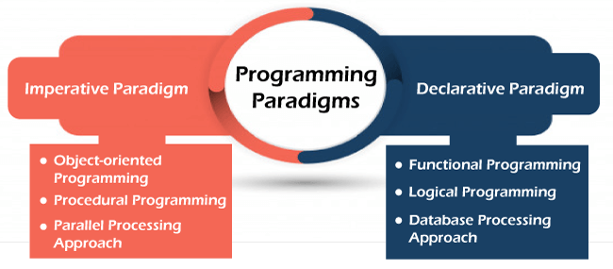

Slide 5
Commonly used Programming Paradigms
Procedural
Oriented Programing
Object Oriented Programming

Slide 6
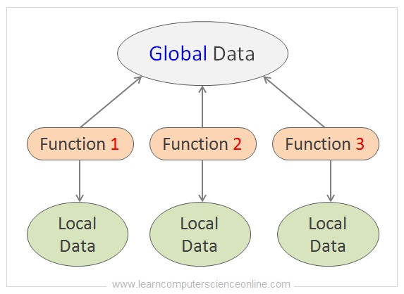
Procedural Programming
It aims at dividing the large problems into small programs called procedures. The procedures also referred to as subroutines, methods or functions.

Slide 7
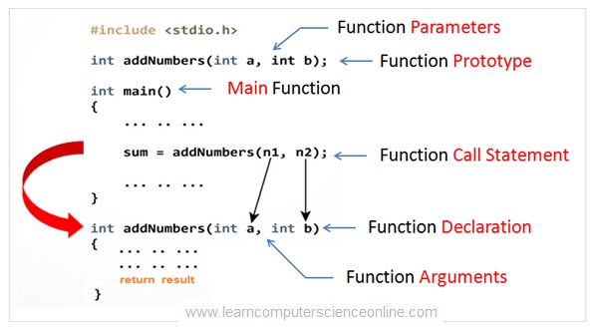

Slide 8
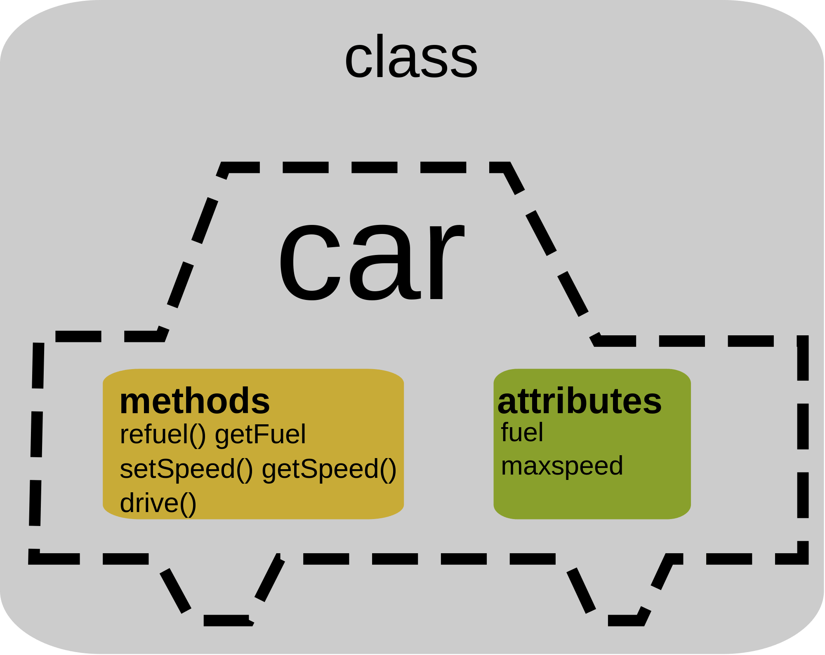
What is OOP
Object Oriented Programming can be defined as a programming model which is based upon the concept of classes and objects. Objects contain data in the form of attributes or properties and code in the form of methods or functions.

Slide 9
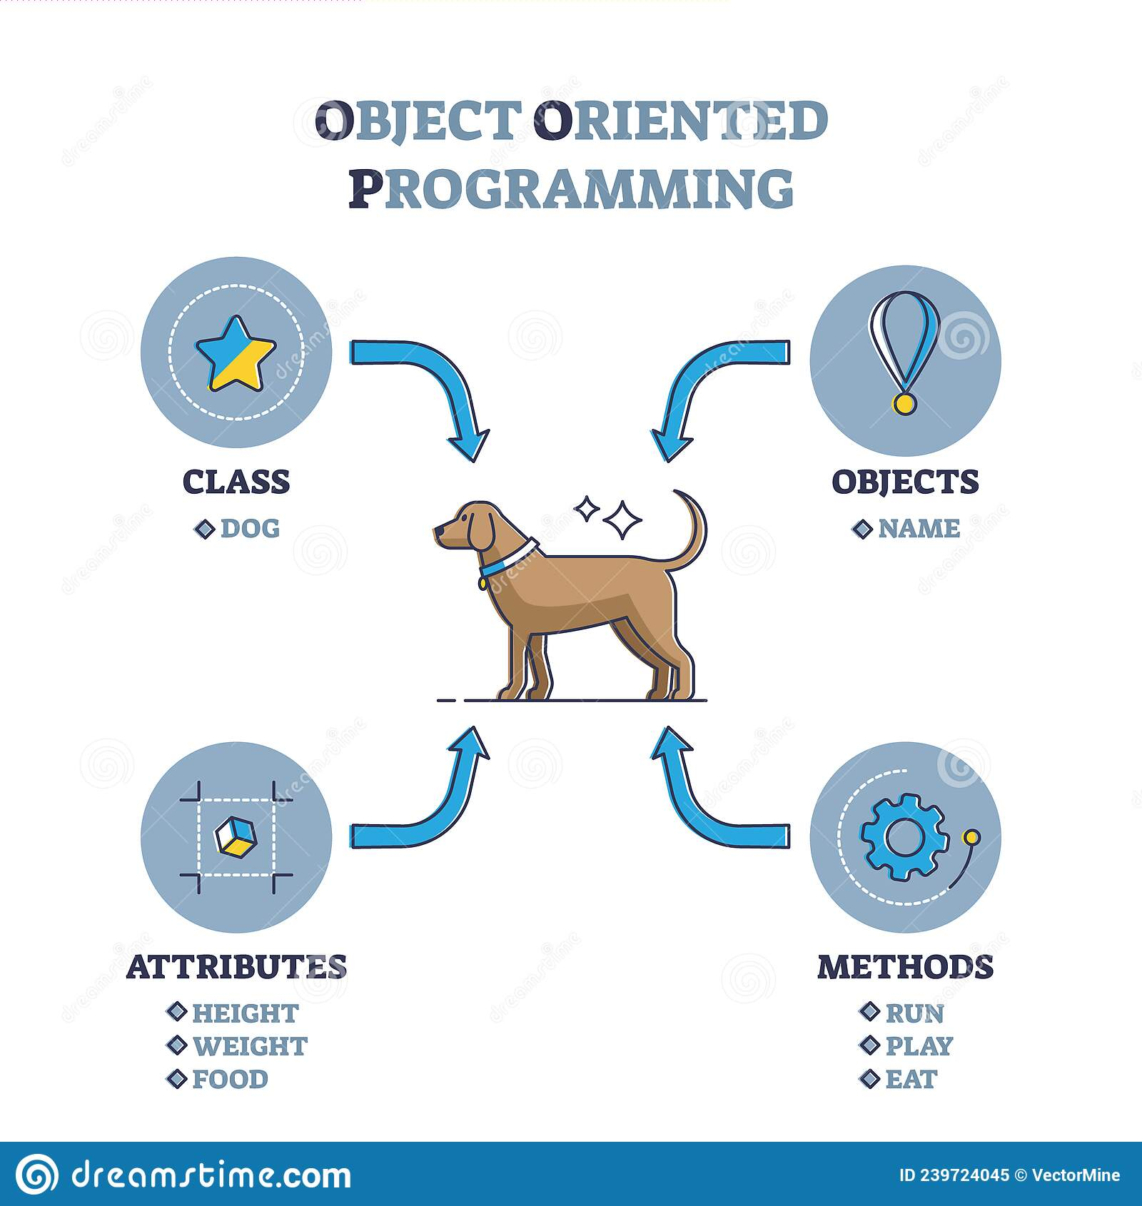

Slide 10
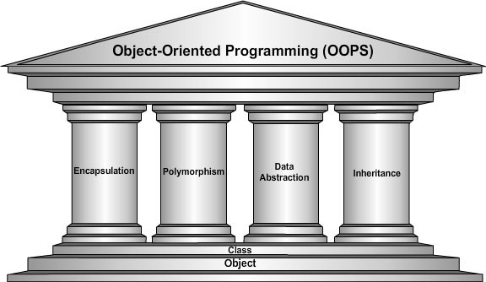
The Four pillars of

Slide 11
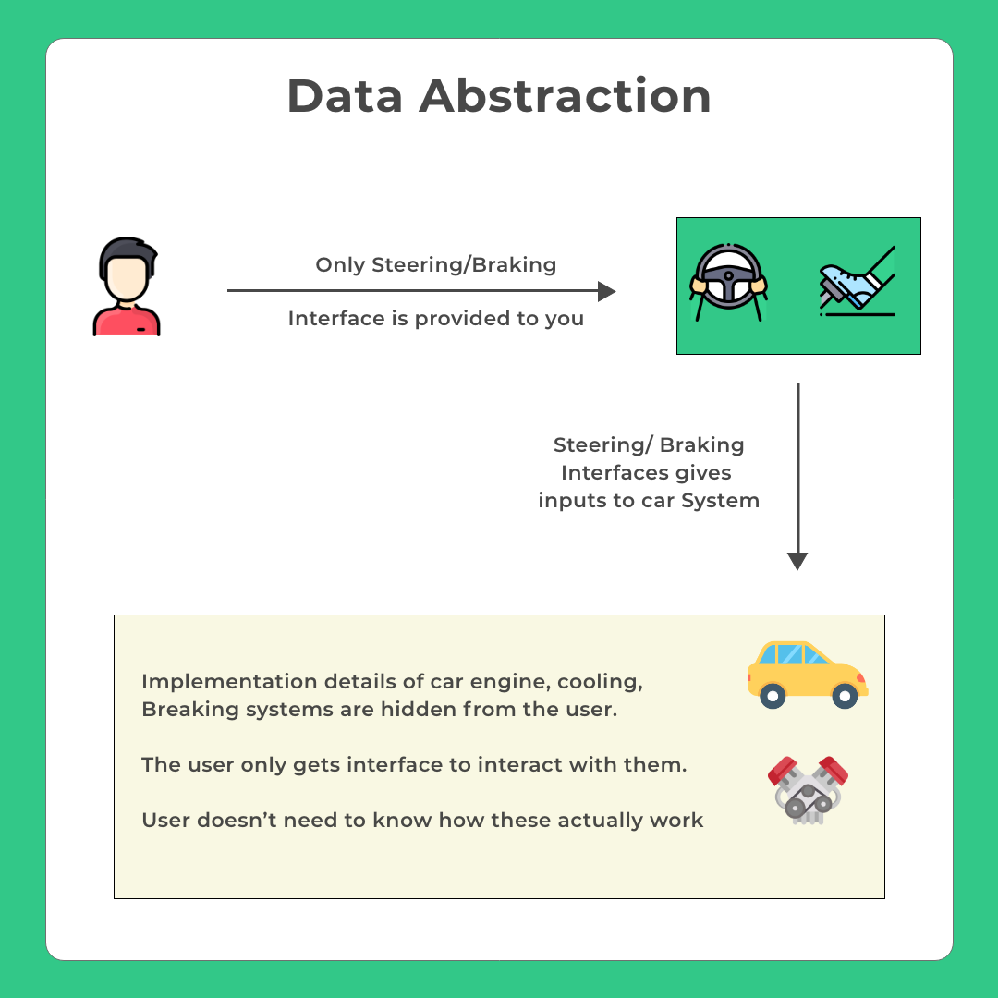
Data Abstraction
Data abstraction is a very important feature of OOP that allows displaying only the important information and hiding the implementation details.

Slide 12
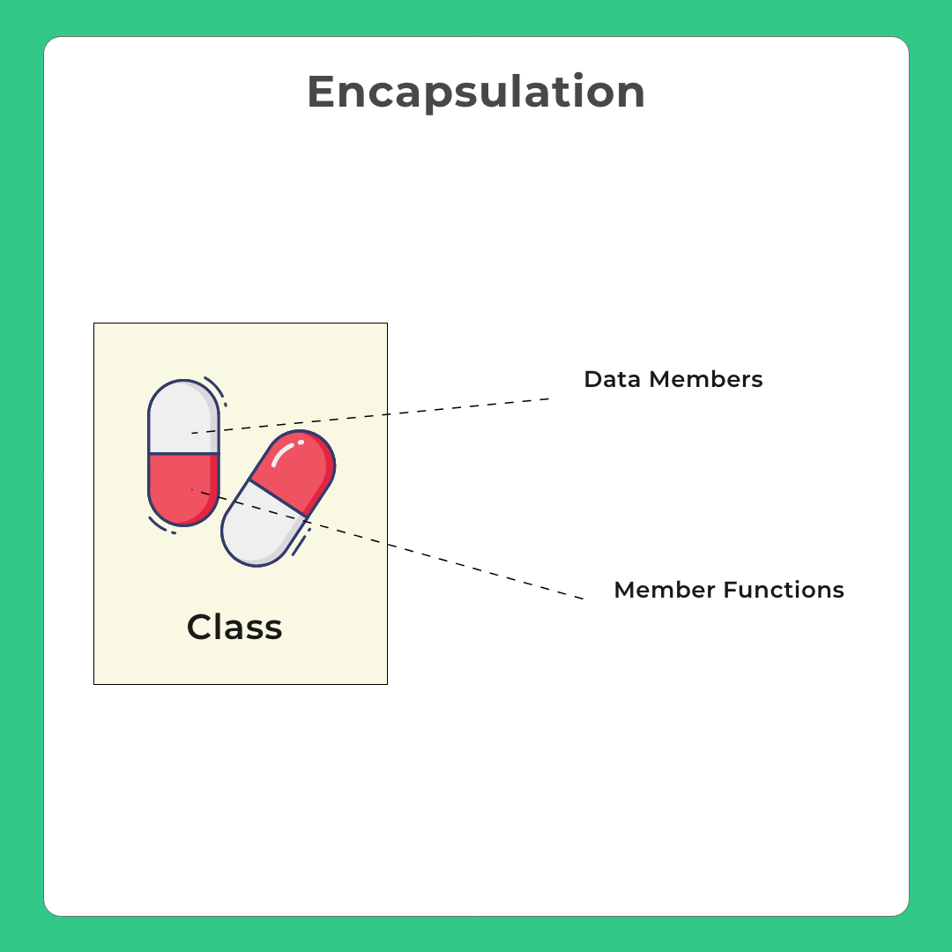
Encapsulation
Encapsulation is a state of binding or wrapping related data or code in one place.

Slide 13
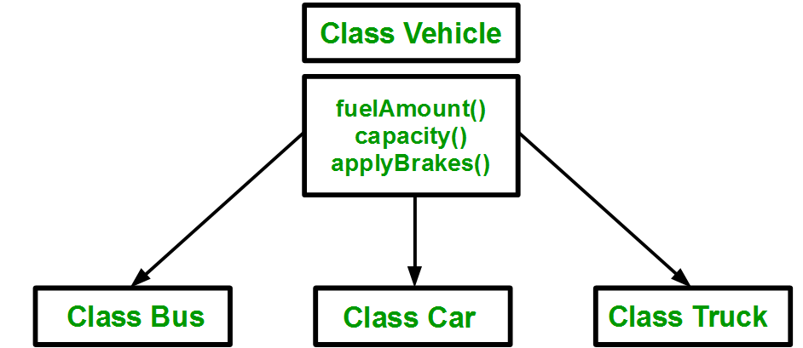
Inheritance
Inheritance is basically the ability of a class to be able to derive its properties and characteristics from a different class.

Slide 14
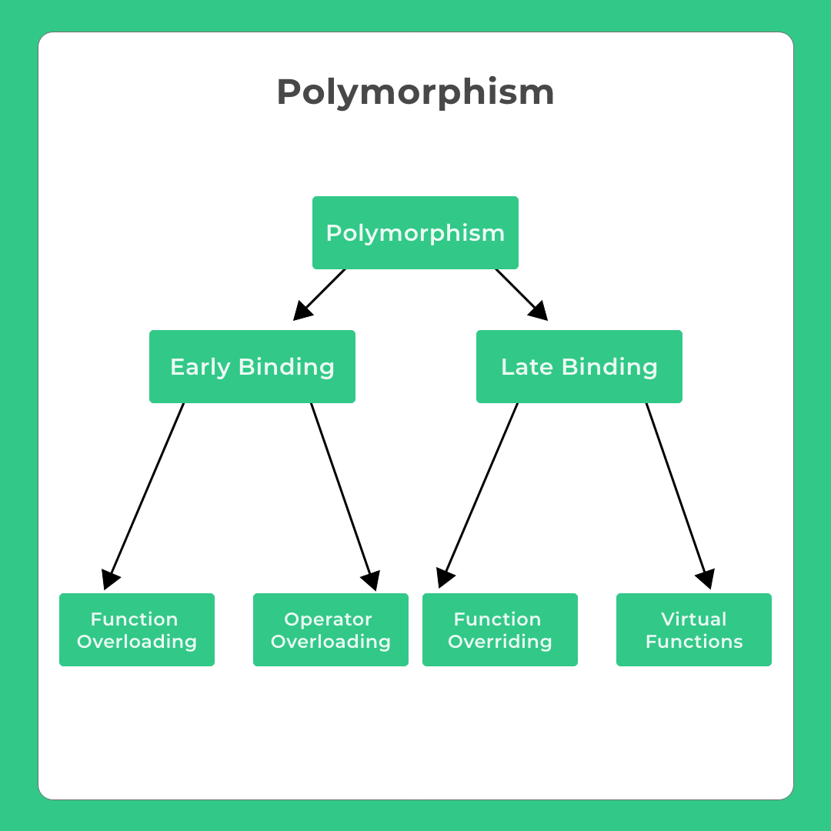
Polymorphism
Polymorphism basically means having multiple existent forms in the program, A simple code may behave differently in different situations.
Polymorphism is of two types –
Static
Dynamic

Slide 15
Access Specifiers and Data Hiding
Data hiding is achieved with the help of Access modifiers as known as Access specifiers. Class members (both data members and member functions) can have varying accessibility depending on the type of access specifier it’s written under.
Types of Access Modifiers
Public
Private
Protected

Slide 16
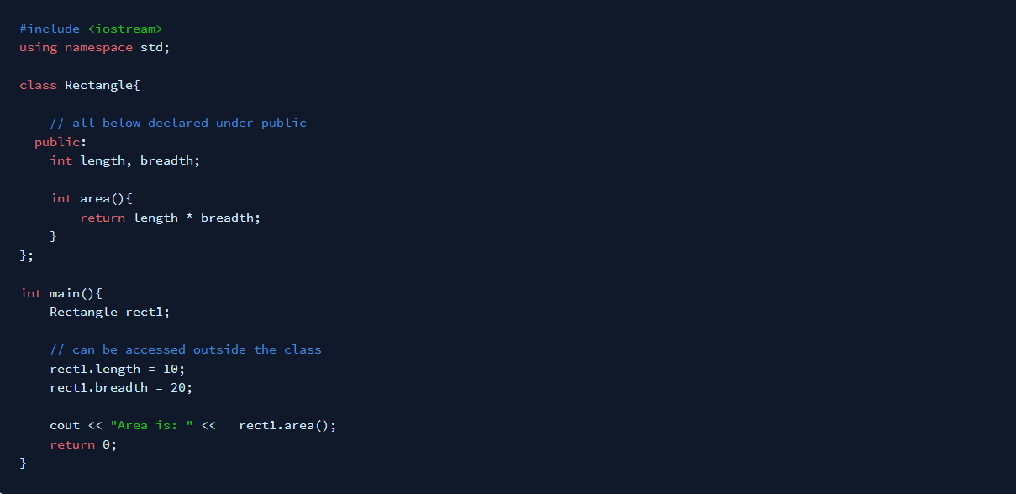
If any class member (data members/member functions) is declared under Public then those class member is accessible to everyone.

Slide 17
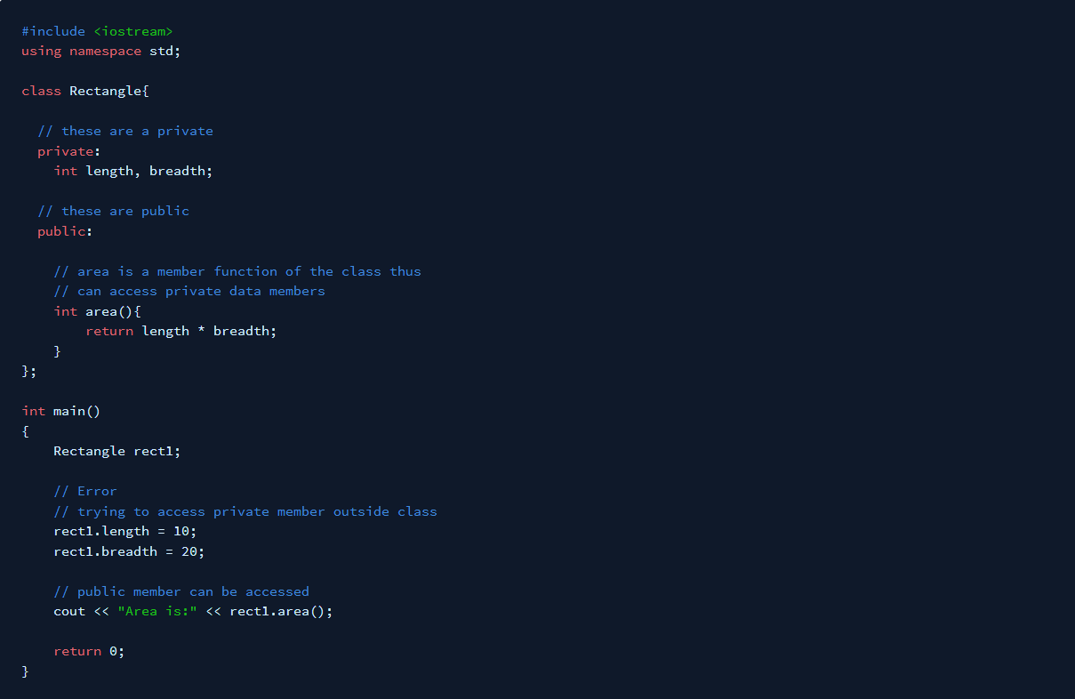

If any class member is declared under Private then –
It Can only be accessed by functions declared inside the class,
Not accessible to the outside world(class)

Slide 18
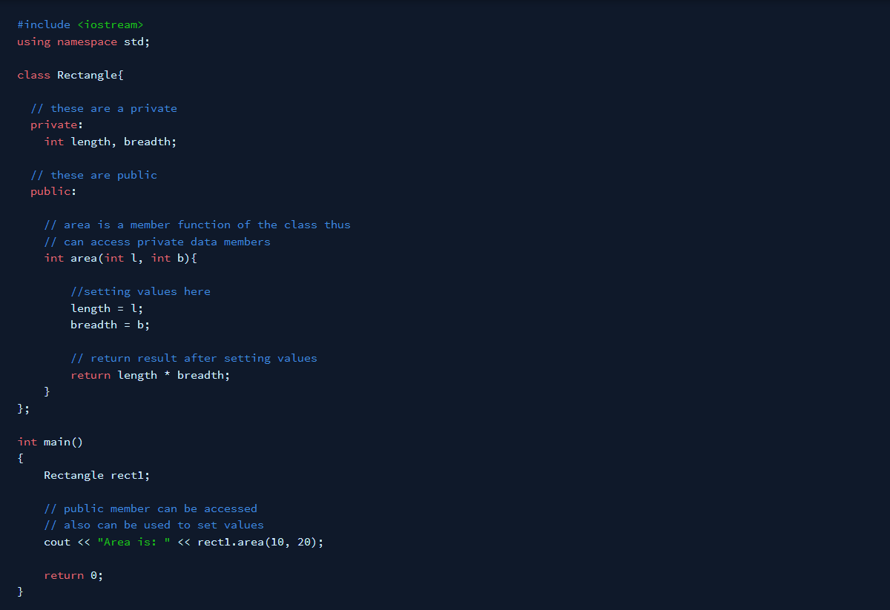

Right way

Slide 19
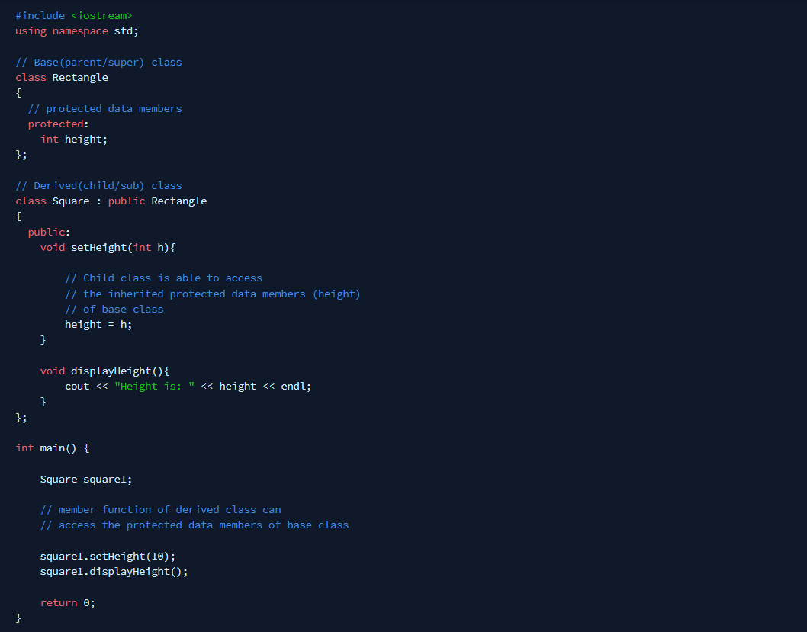
If any class members are declared under-Protected then –
It is the same as private accessibility
But, derived(subclasses/child) classes can also access the protected class members.

Slide 20
Constructors
Constructor is a member function of class, whose name is same as the class.
A constructor is a special type of member function of a class which initializes objects of a class. In C++, Constructor is automatically called when object is created.
Constructor is invoked at the time of object creation. It constructs the values i.e. provides data for the object that is why it is known as constructors.
Constructor does not have a return value, hence they do not have a return type.

Slide 21
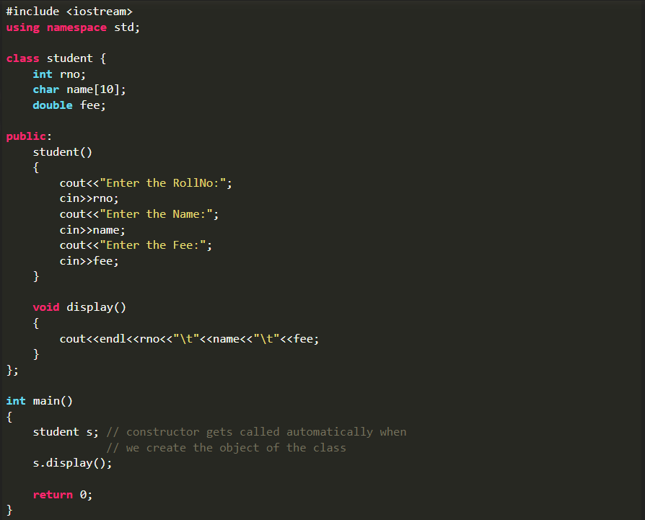

Slide 22
Destructors
Destructor is an instance member function which is invoked automatically whenever an object is going to be destroyed. Meaning, a destructor is the last function that is going to be called before an object is destroyed.
The destructor does not have arguments.
It has no return type not even void.
A destructor should be declared in the public section of the class.

Slide 23
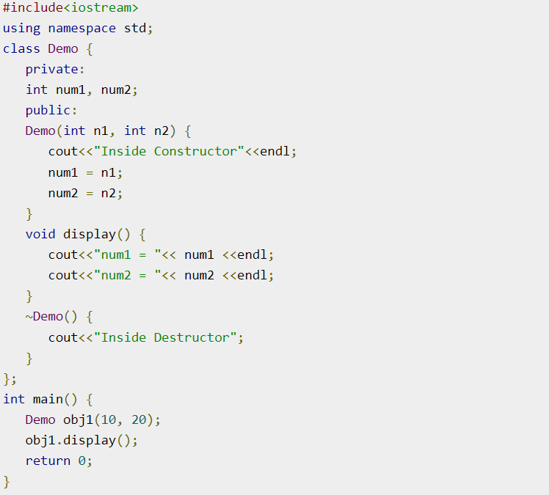
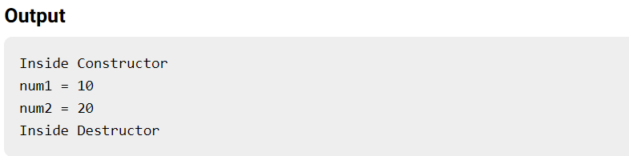

Slide 24
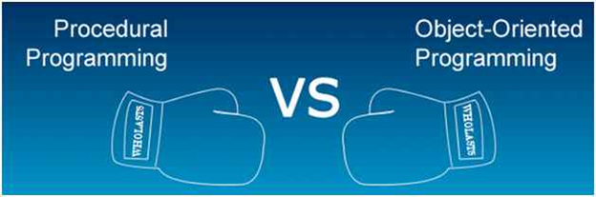

Slide 25
Procedural Programming
Object Oriented Programming
VS
In procedural programming, the program is divided into small parts called functions.
In object-oriented programming, the program is divided into small parts called objects

Slide 26
Procedural Programming
Object Oriented Programming
VS
Object-oriented programming has access specifiers like private, public, protected, etc.
There is no access specifier in procedural programming

Slide 27
Procedural Programming
Object Oriented Programming
VS
In object-oriented programming, the concept of data hiding and inheritance is used. Hence more secure than procedural.
In procedural programming, there is no concept of data hiding and inheritance.

Slide 28
Procedural Programming
Object Oriented Programming
VS
Procedural programming is used for designing medium-sized programs.
Object-oriented programming is used for designing large and complex programs.

Slide 29
Procedural Programming
Object Oriented Programming
VS
In procedural programming, code is not very much reusable throughout the program.
In object-oriented programming, code reusability is High. Due to inheritance

Slide 30





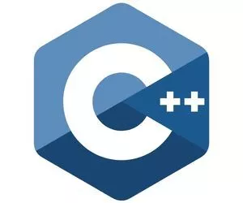

Procedural Programming
Object Oriented Programming
VS

Slide 31
